Slide 1

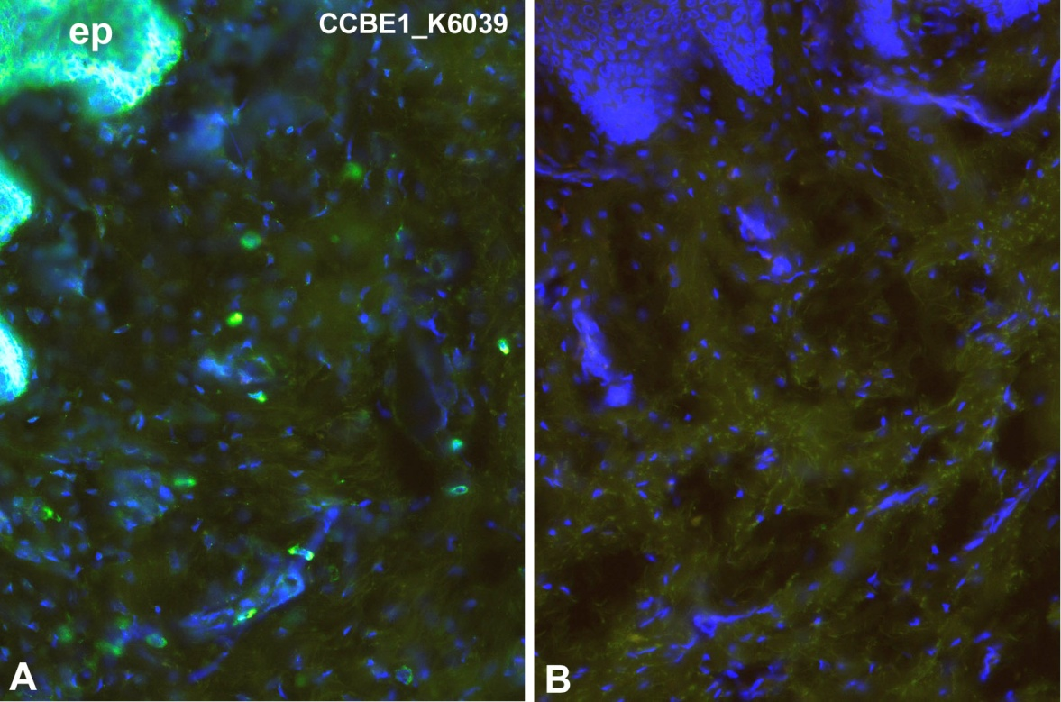
ReliaTech GmbH
Rabbit anti-human ccbe1
„Collagen and calcium-binding EGF domain-containing protein 1“
(Cat #102-PA36S/-PA36)
Immunofluorescence staining (green) of human foreskin (cryo-section of unfixed tissue) with anti-human ccbe1 (K6039; dilution 1:50) [Cat# 102-PA36]. A) Note specific staining in epidermis (ep) and in scattered cells in the dermis. B) Negative control of a consecutive section. Nuclei counter-stained with Dapi (blue). Specimen provided by Prof. Dr. J. Wilting, Goettingen.
The experiment was performed by the research group of Prof. Dr. J. Wilting, University Göttingen, Germany.
http://www.reliatech.de / orders@reliatech.de

